Slide 1


Fauzi Achmad Ramadhan
December 2021

Slide 2

Outline
Executive Summary
Introduction
Methodology
Results
Conclusion
Appendix

Slide 3
Executive Summary
Web scraping to collect Falcon 9 historical launch records from a Wikipedia, Perform Exploratory Data Analysis (EDA) to find some patterns in the data and determine what would be the label for training supervised models. Performing more interactive visual analytics. Create a machine learning pipeline to predict if the first stage will land.
Four machine learning results similar accuracy around 80%, confusion matrix shows that all machine learning models perfectly predict “Land” but poorly predict “did not land” due to very few test dataset

Slide 4
Introduction
Background:
Space X launch rockets with very cheap cost compare to other company, this is because Space X stage 1 rockets can be reuse if its land correctly
Problems:
We (Space Y) want to compete with Space X and want to know when Space X stage 1 rockets will land correctly or not using Machine Learning models and data from Wikipedia Space X historical launch

Slide 5


Slide 6
Methodology
Executive Summary
Data collection methodology:
Getting data from Space X API and Space X Wikipedia page
Perform data wrangling
Convert outcomes into Training Labels with 1 means the booster successfully landed, 0 means it was unsuccessful
Perform exploratory data analysis (EDA) using visualization and SQL
Perform interactive visual analytics using Folium and Plotly Dash
Perform predictive analysis using classification models
Create ML models (sklearn), tune hyperparameters (gridsearchcv), and evaluate using accuracy (score())

Slide 7
Data Collection
The data acquired by collecting from 2 sources, the first one is from Space X public API and the second one is from Space X Wikipedia table.
By using Space X public API we can get data as follow:
FlightNumber, Date, BoosterVersion, PayloadMass, Orbit, LaunchSite, Outcome, Flights, GridFins, Reused, Legs, LandingPad, Block, ReusedCount, Serial, Longitude, and Latitude
By webscrapping table from Space X Wikipedia we can get data as follow:
- Flight No., Launch Site, Payload, Payload Mass, Orbit, Customer, Launch Outcome, Version Booster, Booster Landing, Date, and Time

Slide 8
Data Collection – SpaceX API
Data Collection Flowcharts – Space X API
https://github.com/fauzi417/Final-Chapter-IBM-Data-Science-Space-X/blob/main/Data%20Collection%20API.ipynb
Request Space X API
Decode response as JSON and Get data from API using ID’s
Filter data to only include Falcon 9 launches
Dealing with missing value for Payloadmass using mean
Combine data using dict and create Dataframe

Slide 9
Data Collection - Scraping
Data Collection Flowcharts – Scraping
https://github.com/fauzi417/Final-Chapter-IBM-Data-Science-Space-X/blob/main/Data%20Collection%20with%20Web%20Scraping.ipynb
Request the Falcon9 Launch Wiki page from its URL
Extract all column/variable names from the HTML table header
Combine data using dict and create Dataframe
Create a data frame by parsing the launch HTML tables

Slide 10
Data Wrangling
Data Wrangling
As of the last step in the flowchart, we create a list where the Outcome is failure = 0; otherwise, = 1.
Where failure is 'False ASDS', 'False Ocean', 'False RTLS', 'None ASDS', 'None None‘, other than that is successful outcome
https://github.com/fauzi417/Final-Chapter-IBM-Data-Science-Space-X/blob/main/Wrangling.ipynb
Calculate the number of launches on each site
Calculate the number and occurrence of each orbit
Create a landing outcome label from Outcome column
Calculate the number and occurence of mission outcome per orbit type

Slide 11
EDA with Data Visualization
In this part we visualize variable vs other variable to see the relationship between the 2 variables
List of Variables visualize :
- Flight Number and PayloadMass (Scatter Plot)
Flight Number and Launch Site (Scatter Plot)
Payload and Launch Site (Scatter Plot)
Success rate of each orbit type (Bar Plot)
FlightNumber and Orbit type (Scatter Plot)
Payload and Orbit type (Scatter Plot)
The launch success yearly trend (Line Plot)
Features Engineer that done in this part is create dummy variables for categorical columns (FlightNumber, PayloadMass, Orbit, LaunchSite, Flights, GridFins, Reused, Legs, LandingPad, Block, ReusedCount, Serial)
https://github.com/fauzi417/Final-Chapter-IBM-Data-Science-Space-X/blob/main/EDA%20with%20Visualization.ipynb

Slide 12
EDA with SQL
Load Data to SQL and Connect python to database
Query information about the data like unique value of launch site, total payload mass carried, avg payload mass carried, first ever successful landing in ground, boosters which have success in drone ship and have payload mass greater than 4000 but less than 6000, List the total number of successful and failure mission outcomes, List the names of the booster_versions which have carried the maximum payload mass, List the failed landing_outcomes in drone ship, their booster versions, and launch site names for in year 2015, and Rank the count of landing outcomes (such as Failure (drone ship) or Success (ground pad)) between the date 2010-06-04 and 2017-03-20
https://github.com/fauzi417/Final-Chapter-IBM-Data-Science-Space-X/blob/main/EDA%20with%20SQL%20lab.ipynb

Slide 13
Build an Interactive Map with Folium
Mark all launch sites on a map with circles and markers (name)
Mark the success/failed launches for each site on the map
Calculate the distances between a launch site to its proximities
The purposes of interactive map is to visualize where did the launches take places and where successful landing and failure landing take places
https://github.com/fauzi417/Final-Chapter-IBM-Data-Science-Space-X/blob/main/Interactive%20Visual%20Analytics%20with%20Folium.ipynb

Slide 14
Build a Dashboard with Plotly Dash
Build dashboard of scatter plot and pie chart
Scatter plot can customize the input of payload mass from 0 to 10000kg and can choose all launch sites or single site, help us to figure out how relationship between payload mass and successful landing
Pie chart shows portion of successful and failure landing of all sites or single sites, this chart help us to visualize successful landing rate
https://github.com/fauzi417/Final-Chapter-IBM-Data-Science-Space-X/blob/main/Dash.py

Slide 15
Predictive Analysis (Classification)
Predictive Analysis – Classification
https://github.com/fauzi417/Final-Chapter-IBM-Data-Science-Space-X/blob/main/Data%20Collection%20with%20Web%20Scraping.ipynb
Take out “class” variables from data and store it as target variable
Standarize the data
Create Machine Learning models
Split data into Xtrain, Xtest, Ytrain, and Ytest
Tune the hyperparameter to find the best hyperparameter for train data
Calculate Accuracy of model with test data

Slide 16
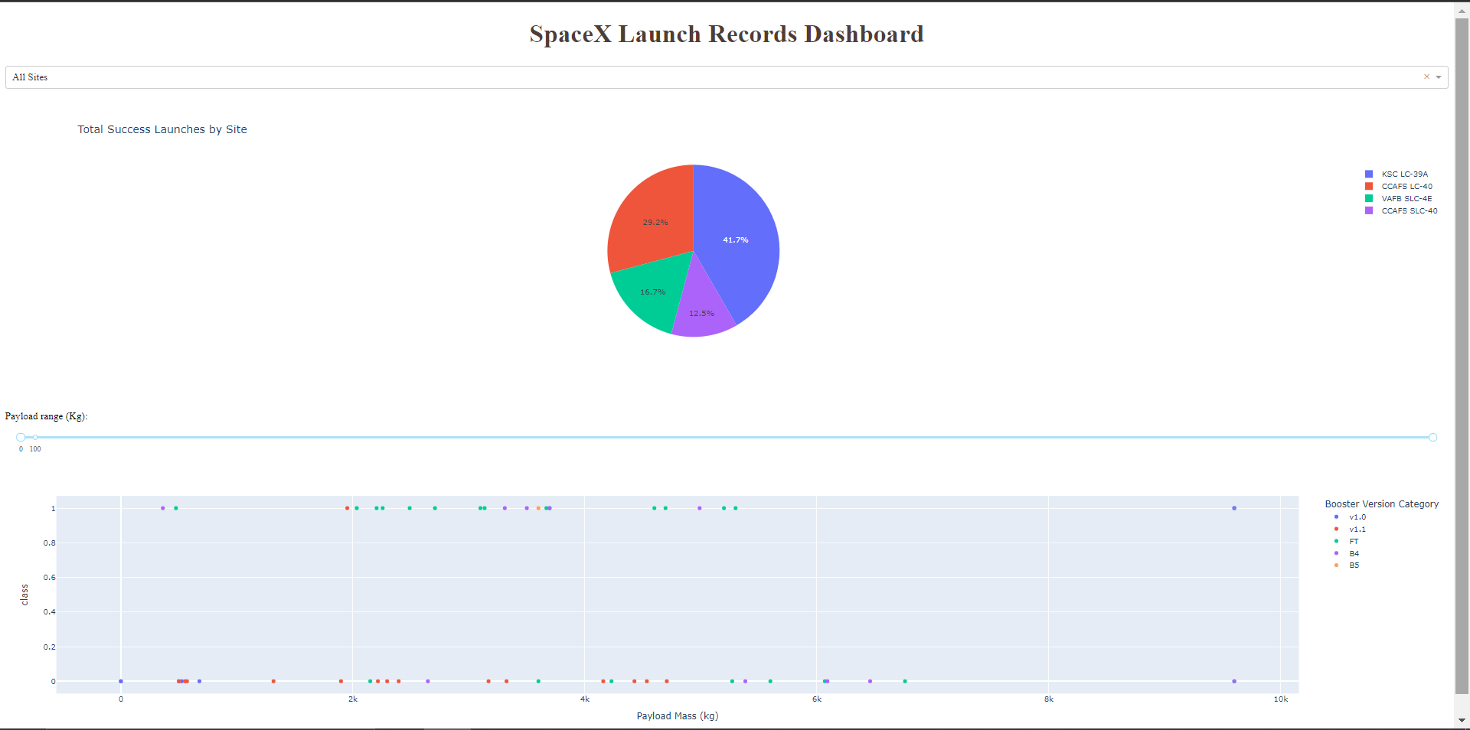
Results
With EDA we get some variables vs variables scatter plot give us more information about successful landing and failure landing, also we can can observe that the sucess rate since 2013 kept increasing till 2020, scatter plot and pie chart demo from dash is shown below
With Predictive analysis, our Machine Learning models highest accuracy is around 83%

Slide 17


Slide 18
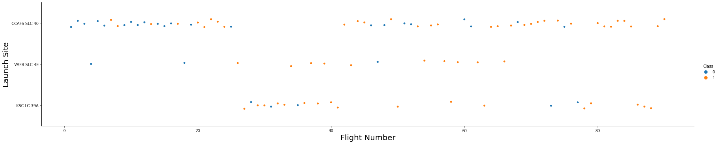
Flight Number vs. Launch Site
Scatter plot of Flight Number vs. Launch Site
Blue is failure and orange is successful
CCAFS SLC 40 has less success rate than VAFB SLC 43 and KSC LC 39A, also when flight number increase, the first stage more likely to land success

Slide 19
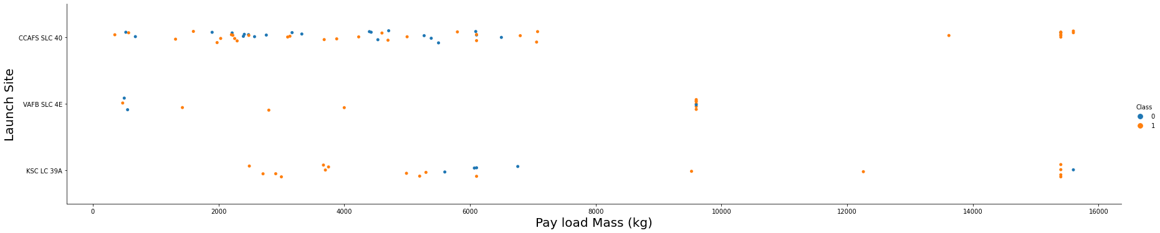
Payload vs. Launch Site
Scatter plot of Payload vs. Launch Site
Blue is failure and orange is successful
VAFB-SLC launchsite there are no rockets launched for heavypayload mass(greater than 10000).

Slide 20
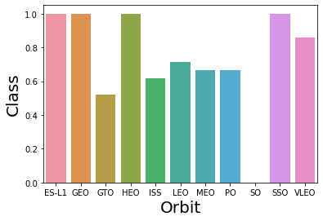
Success Rate vs. Orbit Type
Success Rate vs. Orbit Type
Orbit ES-L1, GEO, HEO, and SSO has 100% success rate, but their sample size are very low (only 1 sample, for SSO has 5 sample), VLEO also has very high success rate with 14 samples

Slide 21
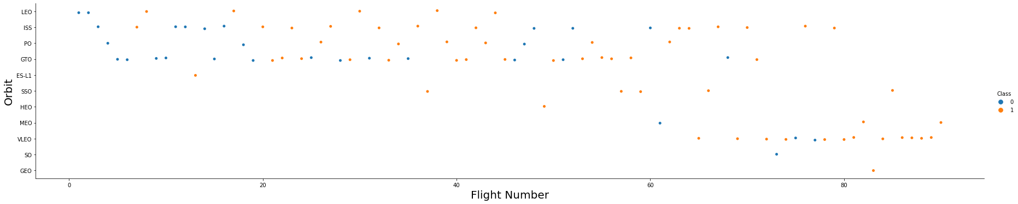
Flight Number vs. Orbit Type
Scatter plot of Flight Number vs. Orbit Type
Blue is failure and orange is successful
LEO orbit the Success appears related to the number of flights. On the other hand, there seems to be no relationship between flight number when in GTO orbit.

Slide 22
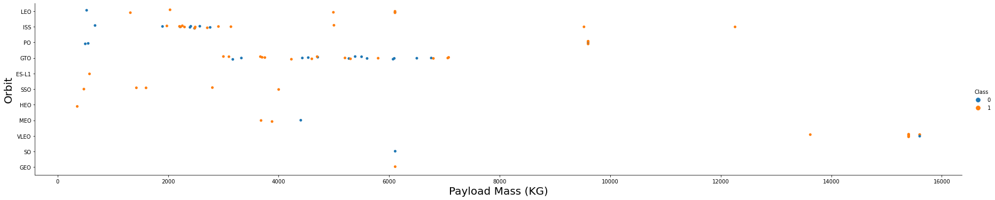
Payload vs. Orbit Type
Scatter plot of Payload vs. Orbit Type
Blue is failure and orange is successful
With heavy payloads the successful landing or positive landing rate are more for Polar, LEO and ISS. However for GTO we cannot distinguish this well as both positive landing rate and negative landing(unsuccessful mission) are both there here

Slide 23
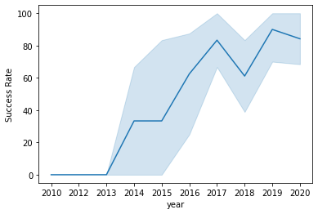
Launch Success Yearly Trend
We can observe that the sucess rate since 2013 kept increasing till 2020

Slide 24
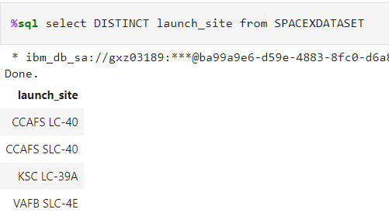
All Launch Site Names
There are 4 unique launch site as shown above

Slide 25
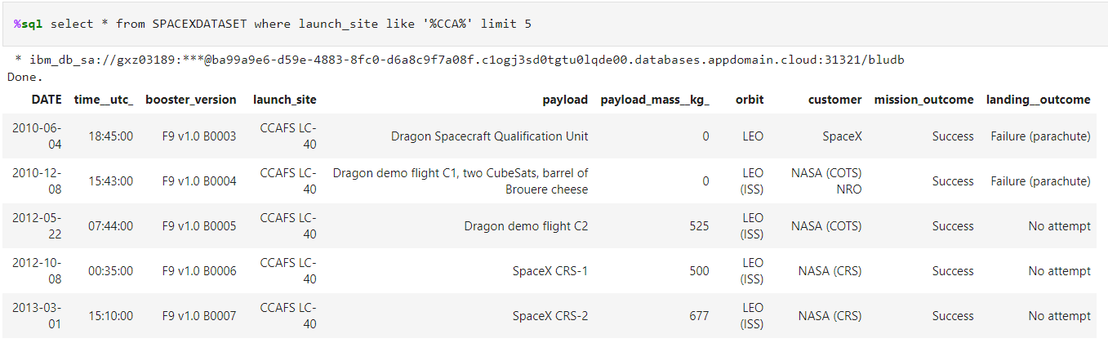
Launch Site Names Begin with 'CCA'
Shown the first 5 data that launch site begin with CCA

Slide 26
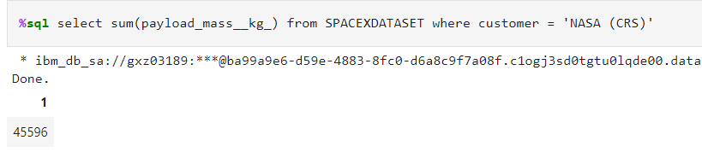
Total Payload Mass
Total Payload Mass is 45596

Slide 27
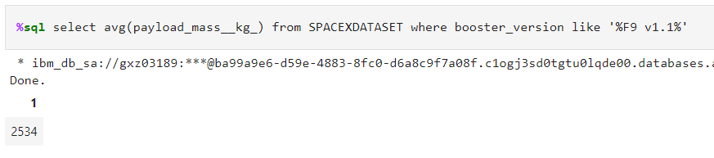
Average Payload Mass by F9 v1.1
Average Payload Mass by F9 v1.1 is 2534

Slide 28
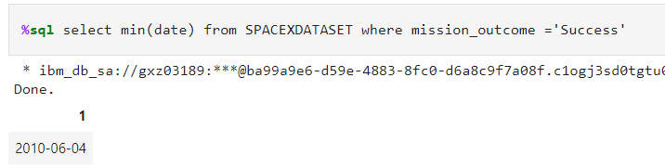
First Successful Landing Date
The first ever successful landing is on 2010-06-04

Slide 29
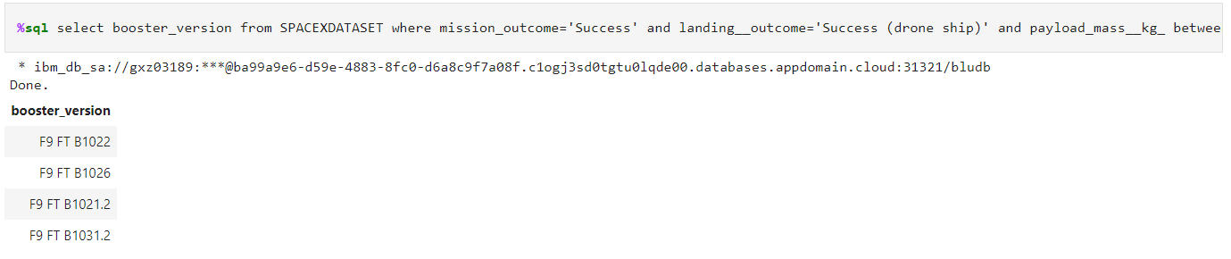
Successful Drone Ship Landing with Payload between 4000 and 6000
Successful Drone ship landing with payload between 4000 and 6000 is shown above

Slide 30
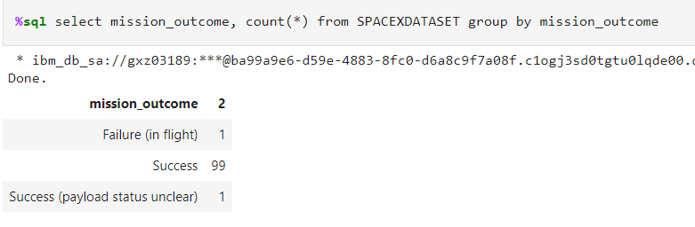
Total Number of Successful and Failure Mission Outcomes
Success mission is 99 compare to failure mission is 1, this means almost all of failure landing are intended by Space X, and with 1 success with payload status unclear

Slide 31
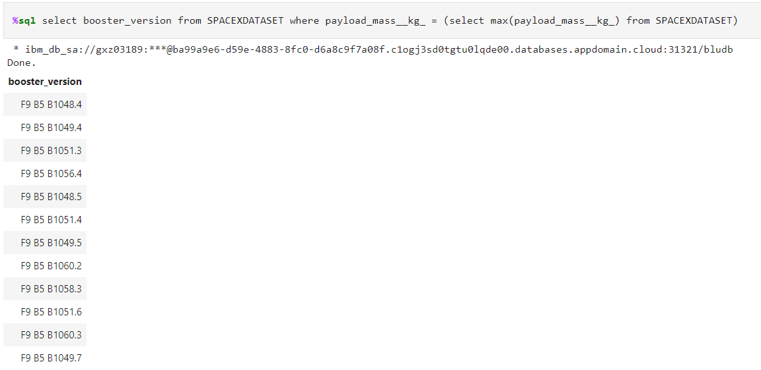
Boosters Carried Maximum Payload
These booster is used to carry maximum payload by Space X, these booster start wit F9 B5 B10 which indicate these type of booster likely intended to carry maximum payload

Slide 32
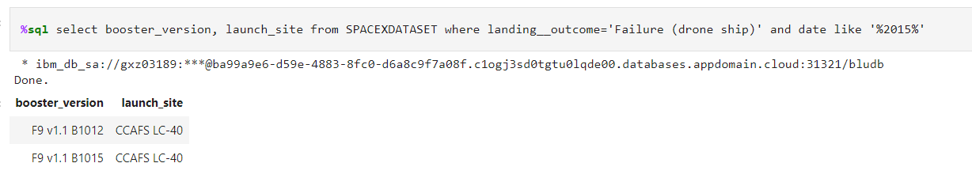
2015 Launch Records
2015 failed drone ship landing occurs 2 times in the same launch site with similar booster version

Slide 33
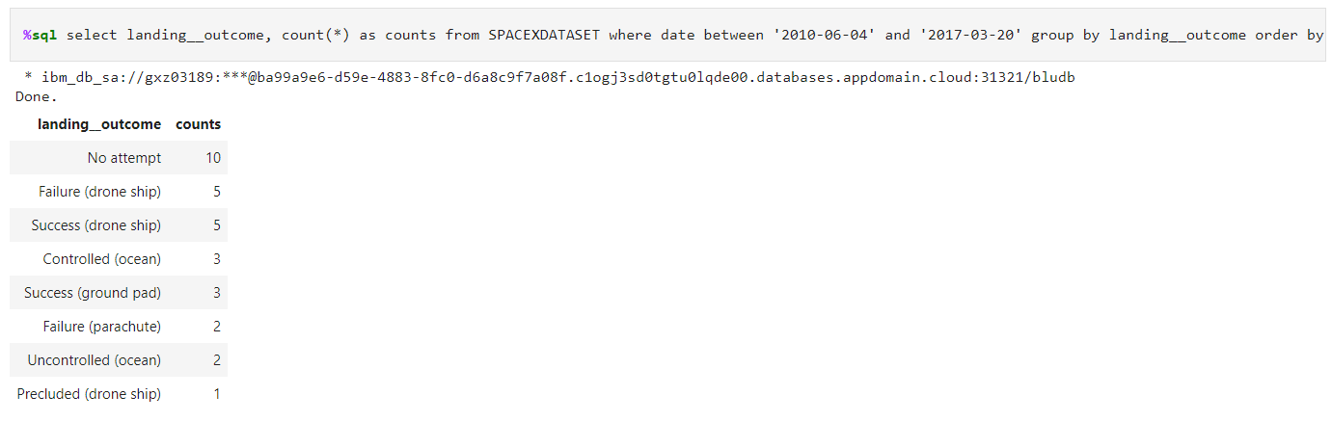
Rank Landing Outcomes Between 2010-06-04 and 2017-03-20
There is 10 launch that didn’t attempt to landing, but drone ship seems to fail and success in 50:50 with each outcome has 5 outcome, followed by controlled ocean and success ground pad with 3 outcome

Slide 34


Slide 35
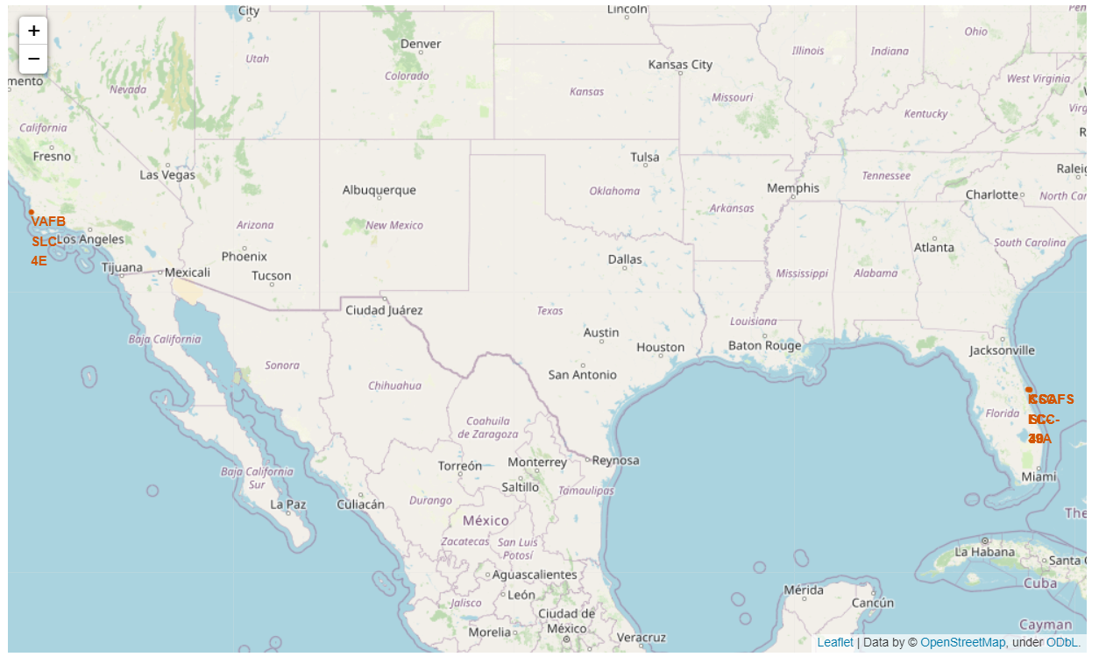
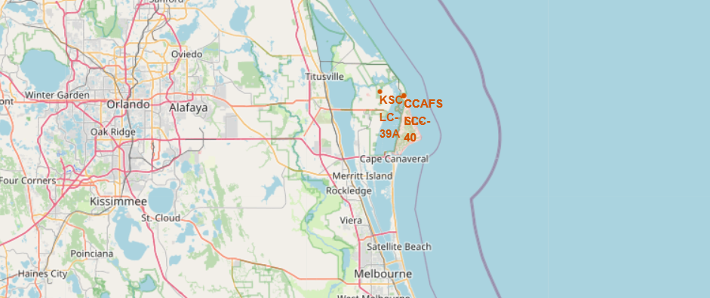
Launch Site with folium
All Sites are near ocean, with KSC LC and CCAFS landing site are close to each other

Slide 36
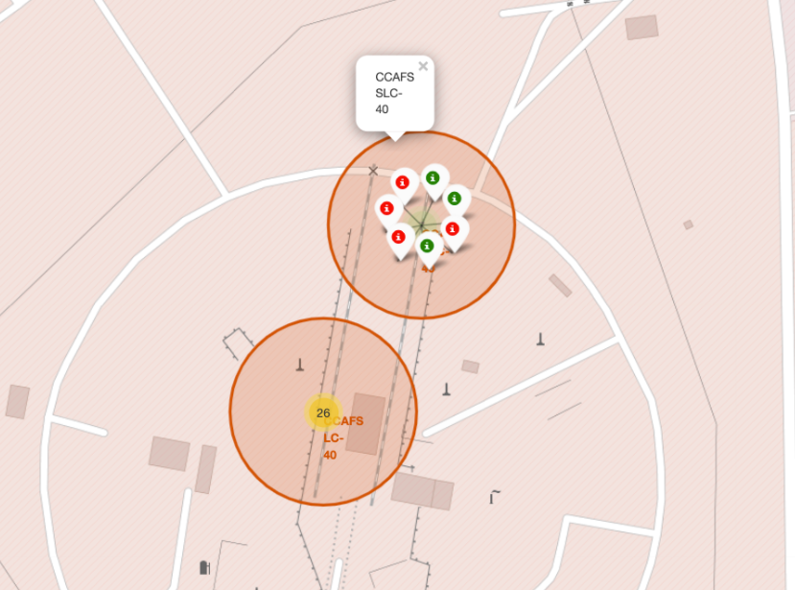
Launch Site successful and failure
In folium the marker can be click to show each launch site successful and failure landing, green shows successful and red for failure, here shown for CCAFS SLC - 40

Slide 37
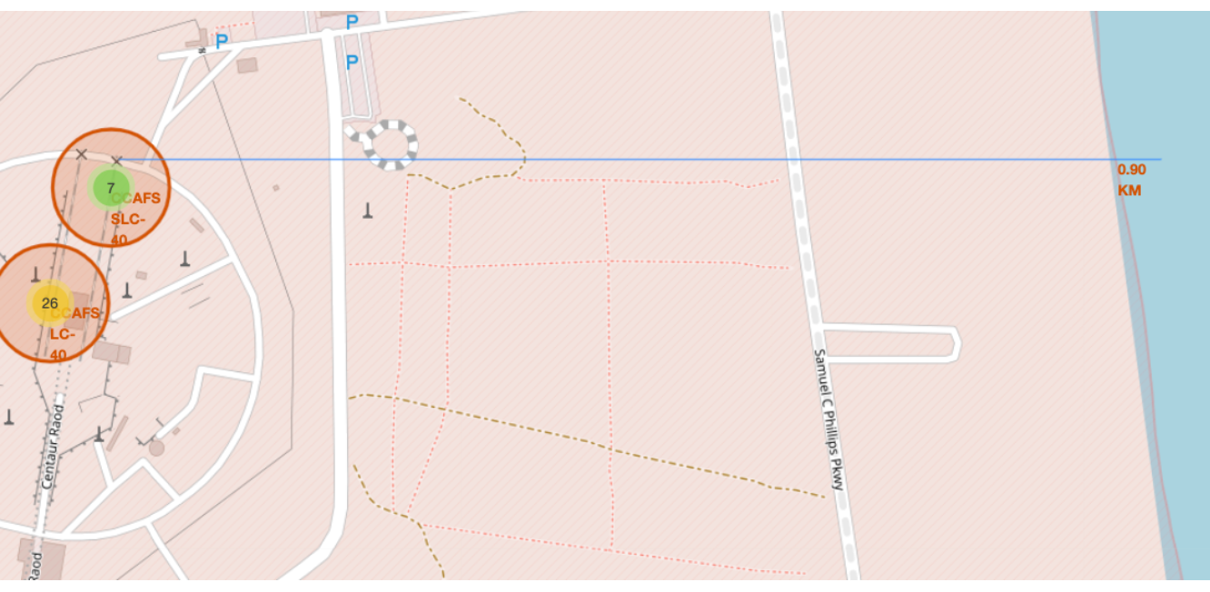
Launch site location
CCAFS SLC to the clostest coasts is 0.90 km

Slide 38


Slide 39
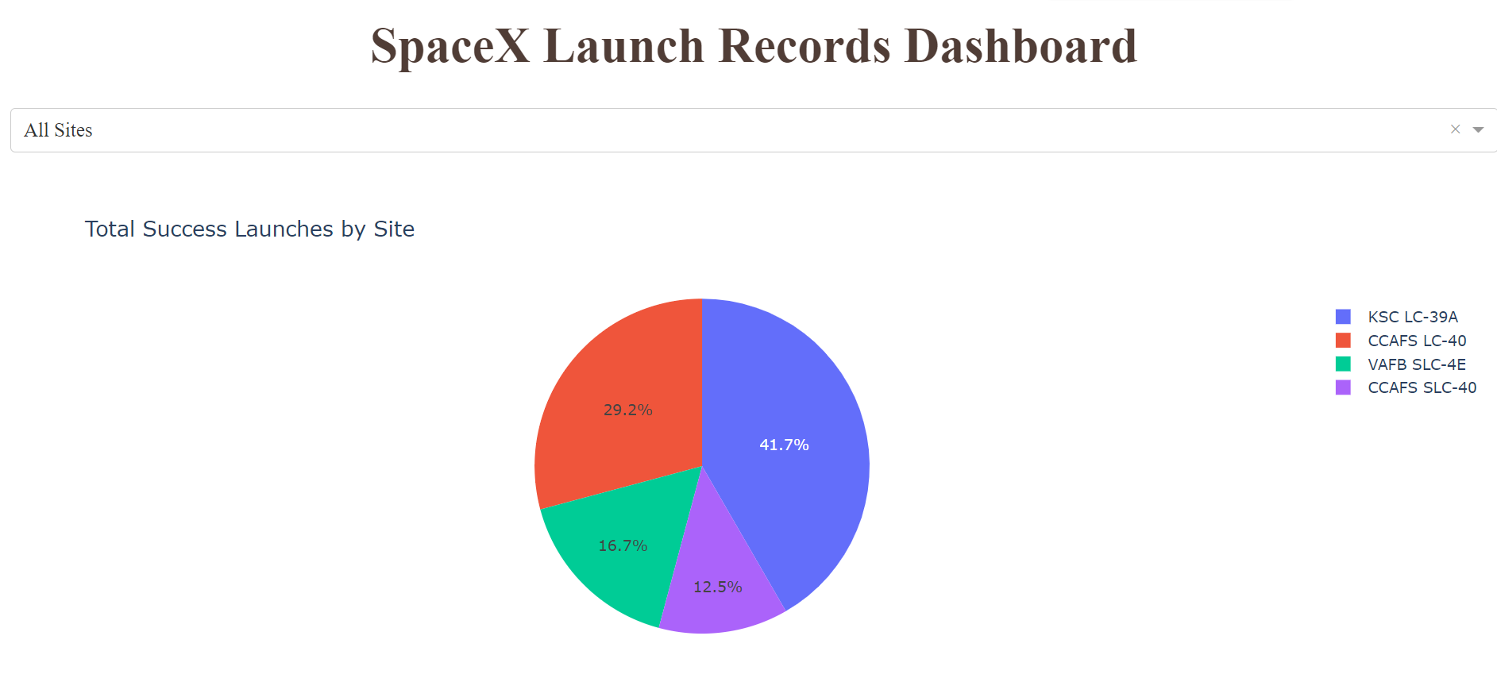
Total Success Launch All Site
The Majority of success launches is on KSC LC-39A Site, behind that is CCAFS LC-40 and CCAFS SLC-40, VAFB SLC-4E has the least success launches

Slide 40
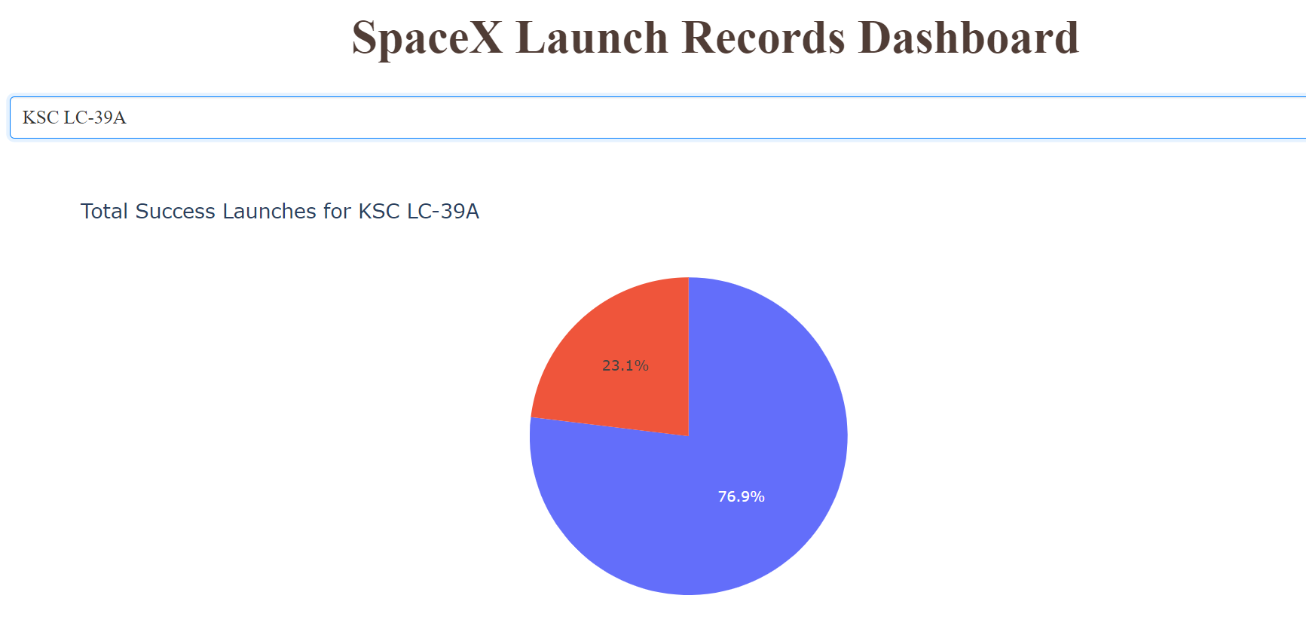
Highest total success launches
As seen in previous slide, KSC LC-39A is the highest launch site success rate, with 76.9 % success landing and 23.1% failure landing

Slide 41
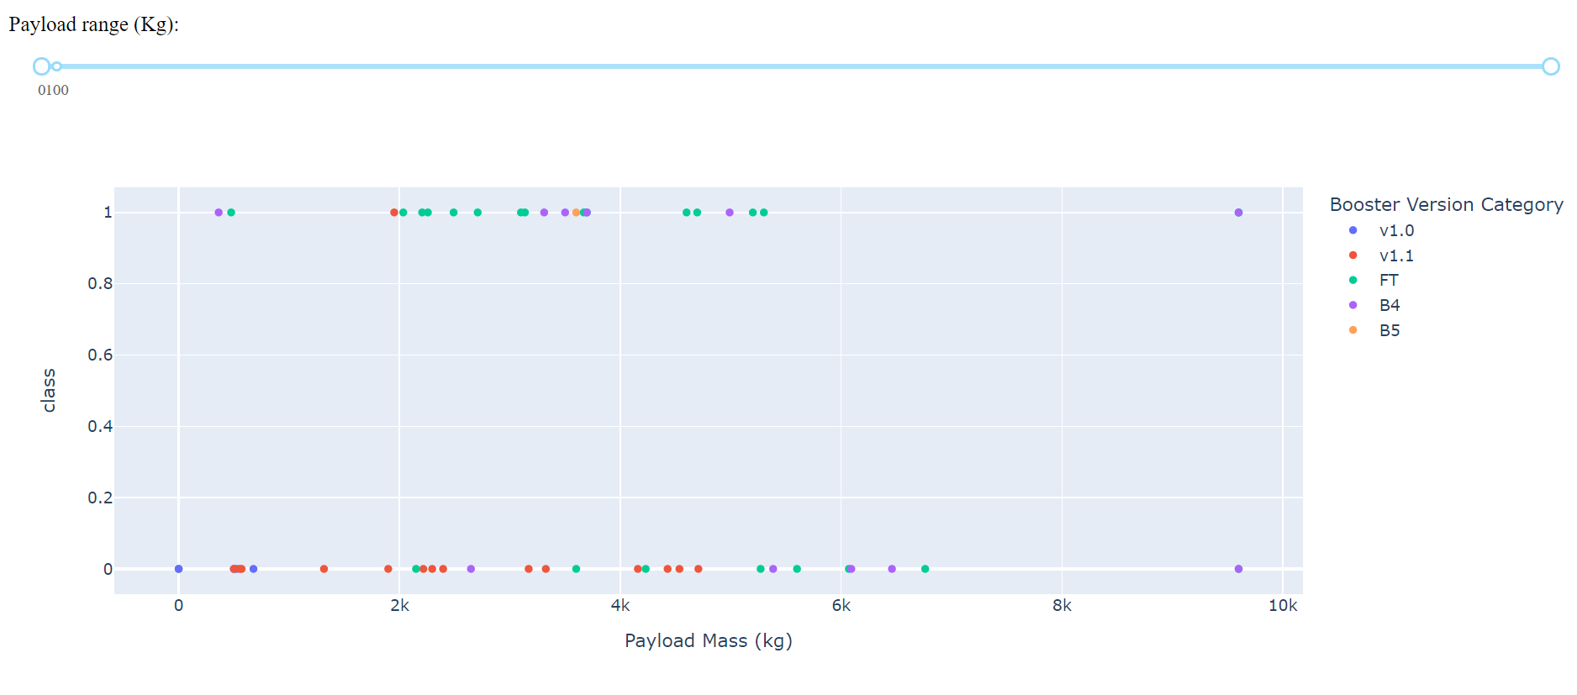
Payload vs Launch Outcome
For booster version FT and B4 have high success rate, but after payload more than 5k kg, both version fail more than the succsess, on the other hand V1.0 and 1.1 have very low success rate, meanwhile B5 only have 1 observation so we can’t conclude anything

Slide 42


Slide 43
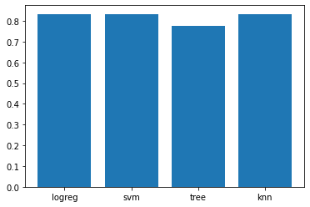
Classification Accuracy
From the analysis, we get Log regression, SVM, and KNN has 83.33% accuracy, meanwhile Decision Tree has 77.77% accuracy, note that this accuracy is generate with 18 data test, so more test data required to determine which model is the best among the other

Slide 44
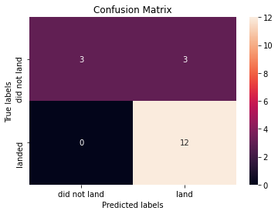
Confusion Matrix
Again as shown is confusion matrix of Log regression, SVM, and KNN that only has 18 test data, they did a really good job on land prediction but not so good on did not land prediction

Slide 45
Conclusions
Our Goal is to predict whether Stage 1 land successful or not, if land successful then Space X will reuse Stage 1 for future launches and save cost of launches.
Space X data acquired from public API and from Wikipedia page.
After EDA, we found there are only 4 launch site (with 2 site approximately the same place) and at site KSC LC is the highest successful landing
Booster Version FT and B4 has the highest successful rate under 5k kg Payload Mass
Orbit type VLEO is the highest successful rate with observation more than 10
Using Machine Learning Model we got 83.33% using Log regression, SVM, and KNN, but these result acquired with minimal test data, more data required to be more precise what model is the best among other.

Slide 46
Appendix
Github: https://github.com/fauzi417/Final-Chapter-IBM-Data-Science-Space-X
Instructors:
Joseph Santarcangelo
Yan Luo
Rav Ahuja
Hima Vasudevan
Aije Egwaikhide
Polong Lin
Saishruthi Swaminathan
Svetlana Levitan
Romeo Kienzler
Azim Hirjani
Saeed Aghabozorgi
Alex Aklson
Lakshmi Holla

Slide 47


